Slide 1
COMP4035 Computer Science Applications
David Lightfoot
Notes by Peter Marshall

Slide 2
Lecture 1: Why am I here?

Slide 3
Today’s lecture
Introduction to the module
Coursework
What is a computing professional?
Computing and Business
Requirements Elicitation

Slide 4
The structure of the module
The module has four parts:
  Semester 1
    Information Systems
    Computer Networking
  Semester 2
    Artificial Intelligence
    Cyber Security
Each part runs for half a semester (6 weeks).
Each part has an associated coursework (each worth 25%)
You must submit Part 1 in Week 6
You must submit Part 2 in Week 12

Slide 5
Part 1: Information Systems
How does a computer professional work in an organisation?
Working in a professional manner
Organisation of the programming process
Process standards
Computer scientists (of whatever flavour) are applied problem solvers
We generally express our solutions to problems in computer code
But there is far more to being a programmer than writing code!
In this part of the module we will look at the context for coding

Slide 6
Coursework
Each tutor will introduce their coursework, but here is brief introduction
  Information Systems: Carry out an activity as a group and reflect on how you worked
  Networking: build a small network in a simulator package.
  Artificial Intelligence: build decision trees to solve a problem.
  Cyber Security: Carry out a Pentest and write a report on it.

Slide 7
Coursework 1
In this coursework, you will be working in a group to develop an initial specification for a computer system.
You will submit an individual report and a group report on the part of the work that you carried out and you will reflect on how well the team worked and on your role in the team.

Slide 8
What is a computing professional?
Possible ways to define it:
Creator versus consumer?
Someone who works in a particular subject area?
Someone who writes code?
Perhaps a skill-based analysis would be more effective

Slide 9
What skillset does a professional programmer need?
Analytical thinking
Logical thought
Understanding of process
Knowledge of programming languages
Capability in using programming tools.
Communication and presentation skills
Planning skills
Collaboration skills
Programming is not just designing, writing and testing code.
We are going to look at the bits beyond the core code-development cycle.

Slide 10
The development process
Requirements
Analysis
Design
Coding/Implementation
Testing
Operation/Deployment
Maintenance
If we don’t get these first three right, it doesn’t matter how good the code is – we’re building the wrong system.

Slide 11
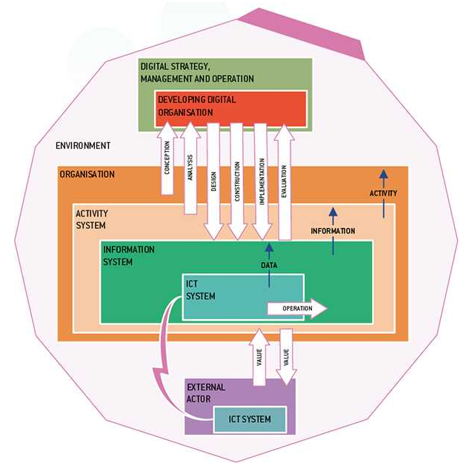
The context for coding: the Business Organisation
Here is an example of where an Information and Communications Technology (ICT) system fits in an organisation
  It exists in a larger environment
  It is just one of the company’s information systems
  The information systems underpin the activities that take place
  The activities define the business
Building this system without an understanding of the larger context would not work.
Ref: Business Information Systems 3rd Ed, Paul Benyon-Davis, Macmillan 2019

Slide 12
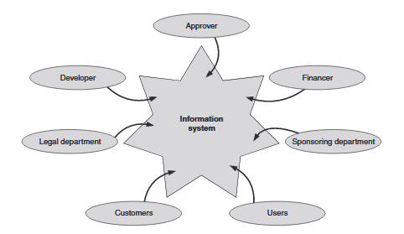
The Business Organisation – Stakeholders
Developers build systems
Users use them
But there is much more to it than that…
Ref: Business Information Systems and Technology: A primer, Lehaney, Lovett & Shah, Routledge 2011

Slide 13
The starting point: Requirements
We need to know what the system needs to do
We elicit a set of requirements to understand the activities that will take place
The functionality of the system will support these activities
We need to speak to both users and other stakeholders
We consider the current system and what can be learned from it
  We thus consider the activity system as well as the technical system

Slide 14
Methods for Requirements Elicitation
Interviews
Questionnaires
Observation

Slide 15
Scenarios
A scenario is a story or narrative that describes some part of the operations.
It will use actual characters and tasks:
  A scenario:
  Mary asks the salesperson for a ticket for that night’s performance
  The salesperson asks Mary where she would like to sit
  Mary picks a seat
  The salesperson confirms the availability and price
  Mary offers payment
  The salesperson marks the seat as booked and generates a ticket that they give to Mary

Slide 16
Generating Requirements
Identify domain properties and hypotheses from the scenarios
Identify any problems in the current system
Set objectives or goals for the system to be built
Properties: tickets, seats
Hypotheses: seat pricing varies depending on seat position
Problem: Current paper-based system doesn’t allow for showing prices on the seat map, as prices vary for different shows
Goal: the new system will allow customers to see seat location, availability and cost

Slide 17
Objective/Goal Decomposition
Goals can be broken down into sub-goals
Requirements can be identified
Expectation can be identified
Goal: the new system will allow customers to see seat location, availability and cost
Sub-goal: Seat map shows currently available seating
Sub-goal: Seat map shows pricing for each seating block
Seats can be selected on the seat map
Seat availability is updated as soon as a sale is made
Seat map should accurately reflect the physical position of seats in the auditorium

Slide 18
Functional Requirements
Functional requirements:
  describe the intended functions that the new software will provide
  can be given priorities related to their perceived importance or risk
Priorities should be assessed in terms of the goals/objectives that they help to meet

Slide 19
Non-functional Requirements
These are requirements that describe how the software will operate
Can include things such as:
  Performance
  Reliability
  Usability
  Security
  …

Slide 20
Where do we go from here?
Functional and non-functional requirements are a starting point
If we consider the actors involved in carrying out the functions we can generate use cases.
Use-case diagrams show how each actor is involved in carrying out a function
Once we know what the system needs to do, we can design a solution in the form of data structures and functionality
Once we have a design we can write code to meet it.
Use-case diagrams are a starting point for modelling systems using Unified Modeling Language (UML)
Code is the definition of data structures and the actions to be carried out on the data

Slide 21
Summary
A computing professional applies their skills in a professional manner
Their skillset goes beyond the technical
Computer systems exist in a context
Understanding this context is vital to developing
effective systems
Requirements elicitation allows the specification of what a system needs to do by considering system functionality in the larger context of the tasks that users are carrying out and the environment in which they do so.

